Slide 1
TriMet Trip Planning Assets
A Visual Description of all TriMet
Trip Planning Information Pages
November 2016

Slide 2
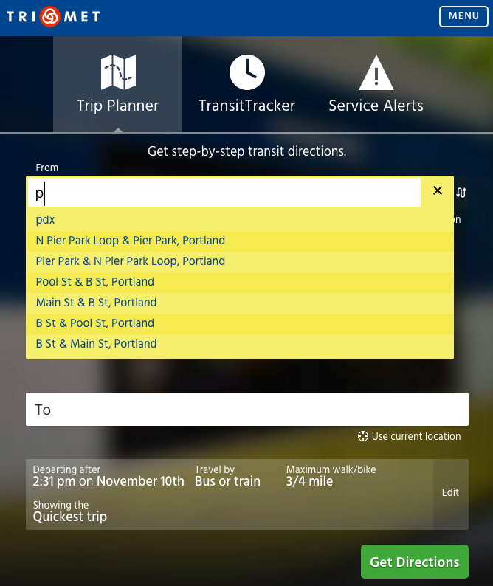
trimet.org/#planner

Slide 3
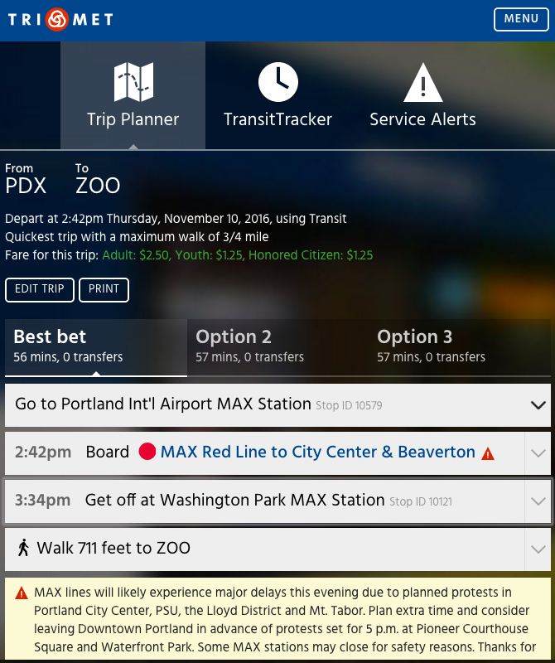
trimet.org/#planner

Slide 4
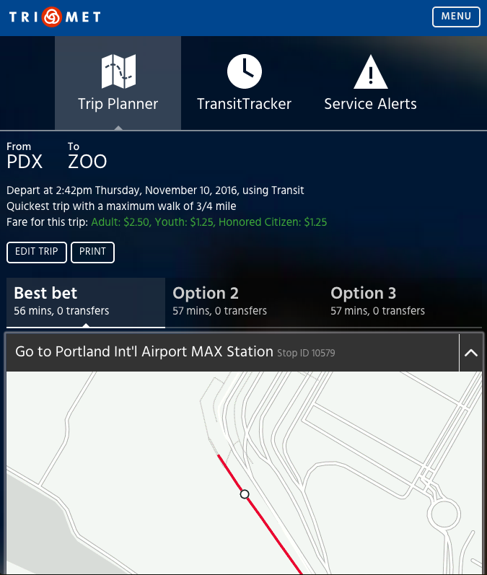
trimet.org/#planner

Slide 5
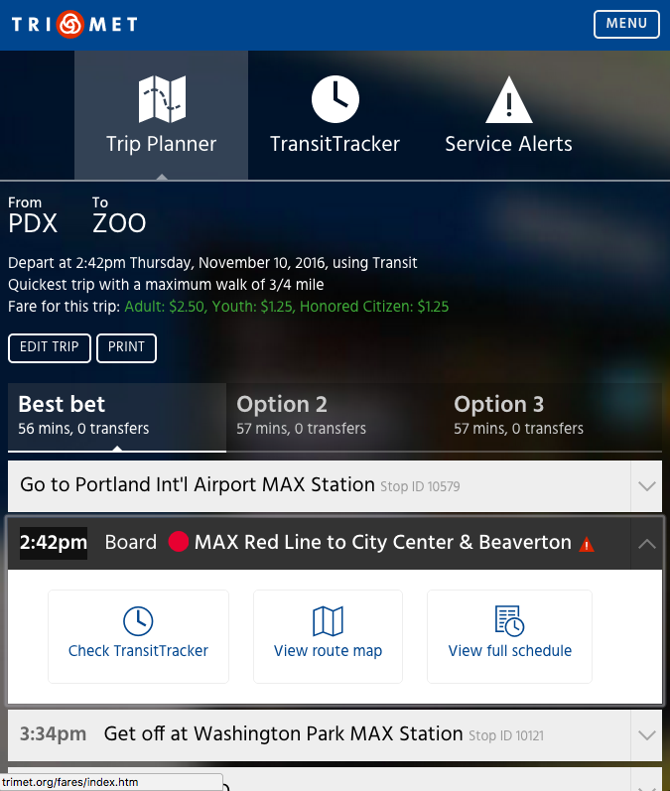
trimet.org/#planner

Slide 6
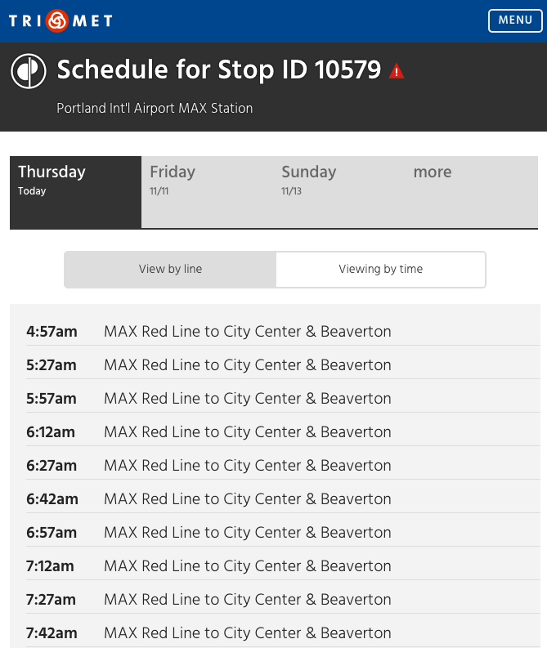
trimet.org Stop Schedule

Slide 7
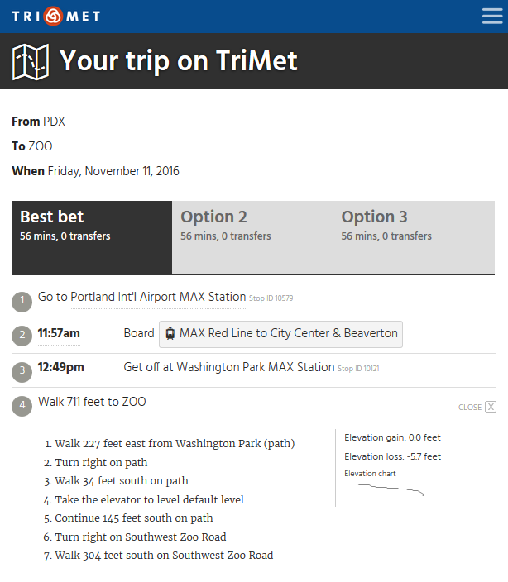
trimet.org Text Planner Links

Slide 8
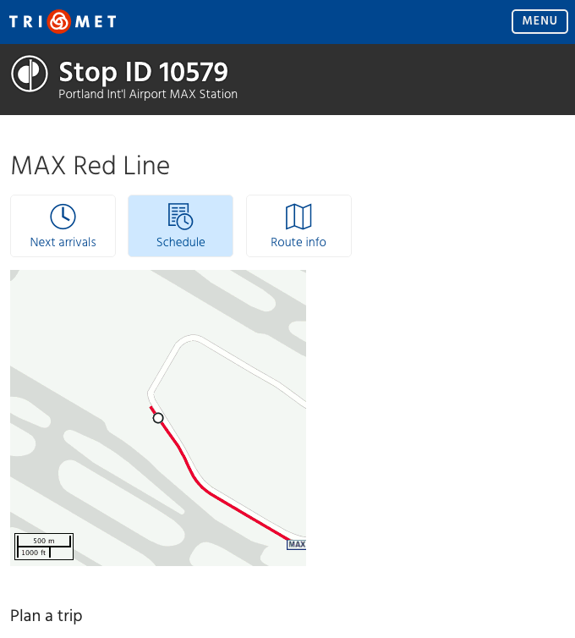
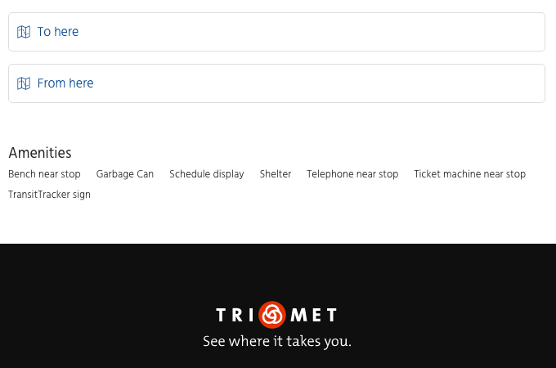
trimet.org Stop Landing Page

Slide 9
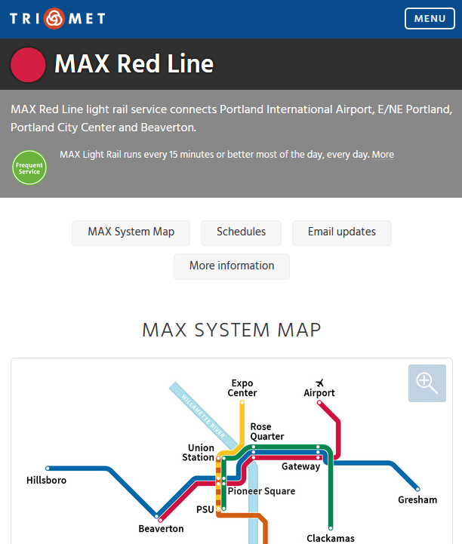
trimet.org Route Landing Page

Slide 10
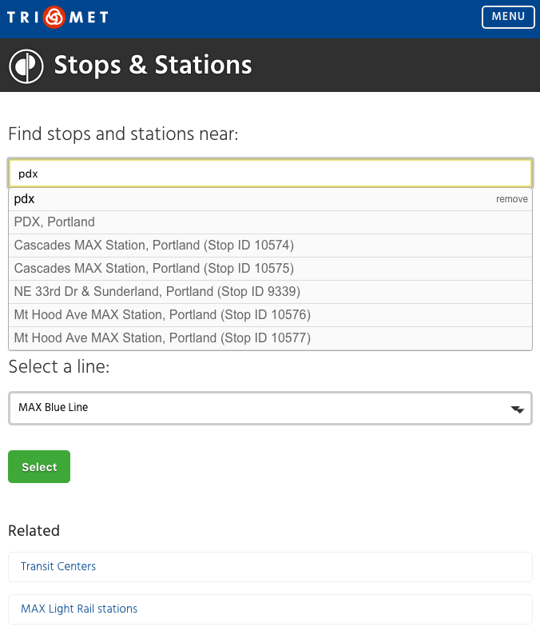
trimet.org Stop Select List

Slide 11
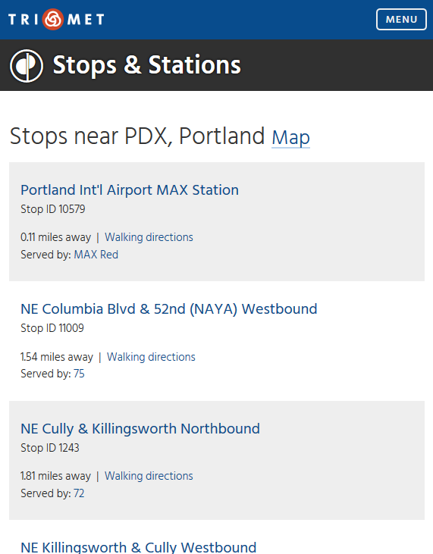
trimet.org Nearest Stops List

Slide 12
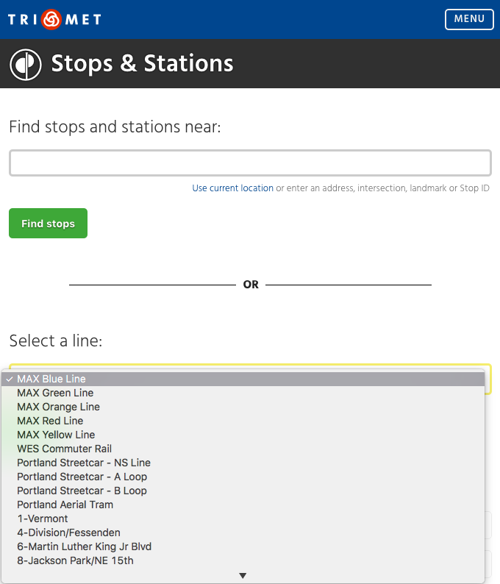
trimet.org Stop Select List

Slide 13
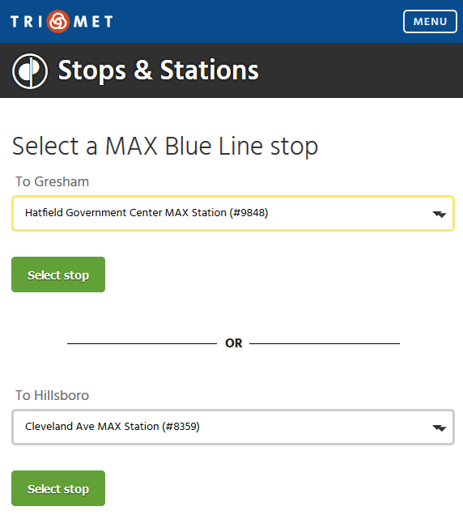
trimet.org Stop Select List

Slide 14
TriMet Interactive Maps
a list of all map apps
internal and externally facing
that we maintain here at TriMet

